Slide 1


Slide 2
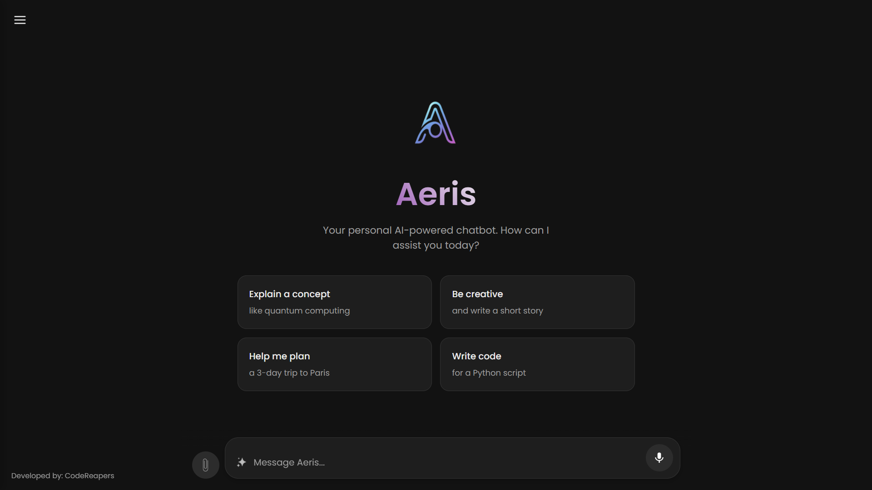
PROJECT: AERIS

Slide 3
The Vision
  Creating a responsive, personal AI assistant.
  Evolve beyond a simple Q&A bot.
  Key Pillars:
    Conversational Memory: Remembering past interactions.
    Adaptability: Providing creative and varied responses.
    Capability: Performing tasks beyond just talking.
    Evolution: Learning from user feedback over time.
PROJECT: AERIS
Presenters:- CodeReapers
Aeris:
An Ai chatbot that is capable of performing chats Reasoning , coding, identify the text from the files , summary etc.

Slide 4

PROJECT: AERIS
The Vision
  Creating a responsive, personal AI assistant.
  Evolve beyond a simple Q&A bot.
  Key Pillars:
    Conversational Memory: Remembering past interactions.
    Adaptability: Providing creative and varied responses.
    Capability: Performing tasks beyond just talking.
    Evolution: Learning from user feedback over time.
Presenters:- CodeReapers
Aeris: An Ai chatbot that is capable of performing basic chats Reasoning , identify the text from the files and

Slide 5
The Aeris Architecture
A simple, high-level diagram with four main components.
Ai model:- llama3
Front end:- HTML, CSS, JS

Slide 6
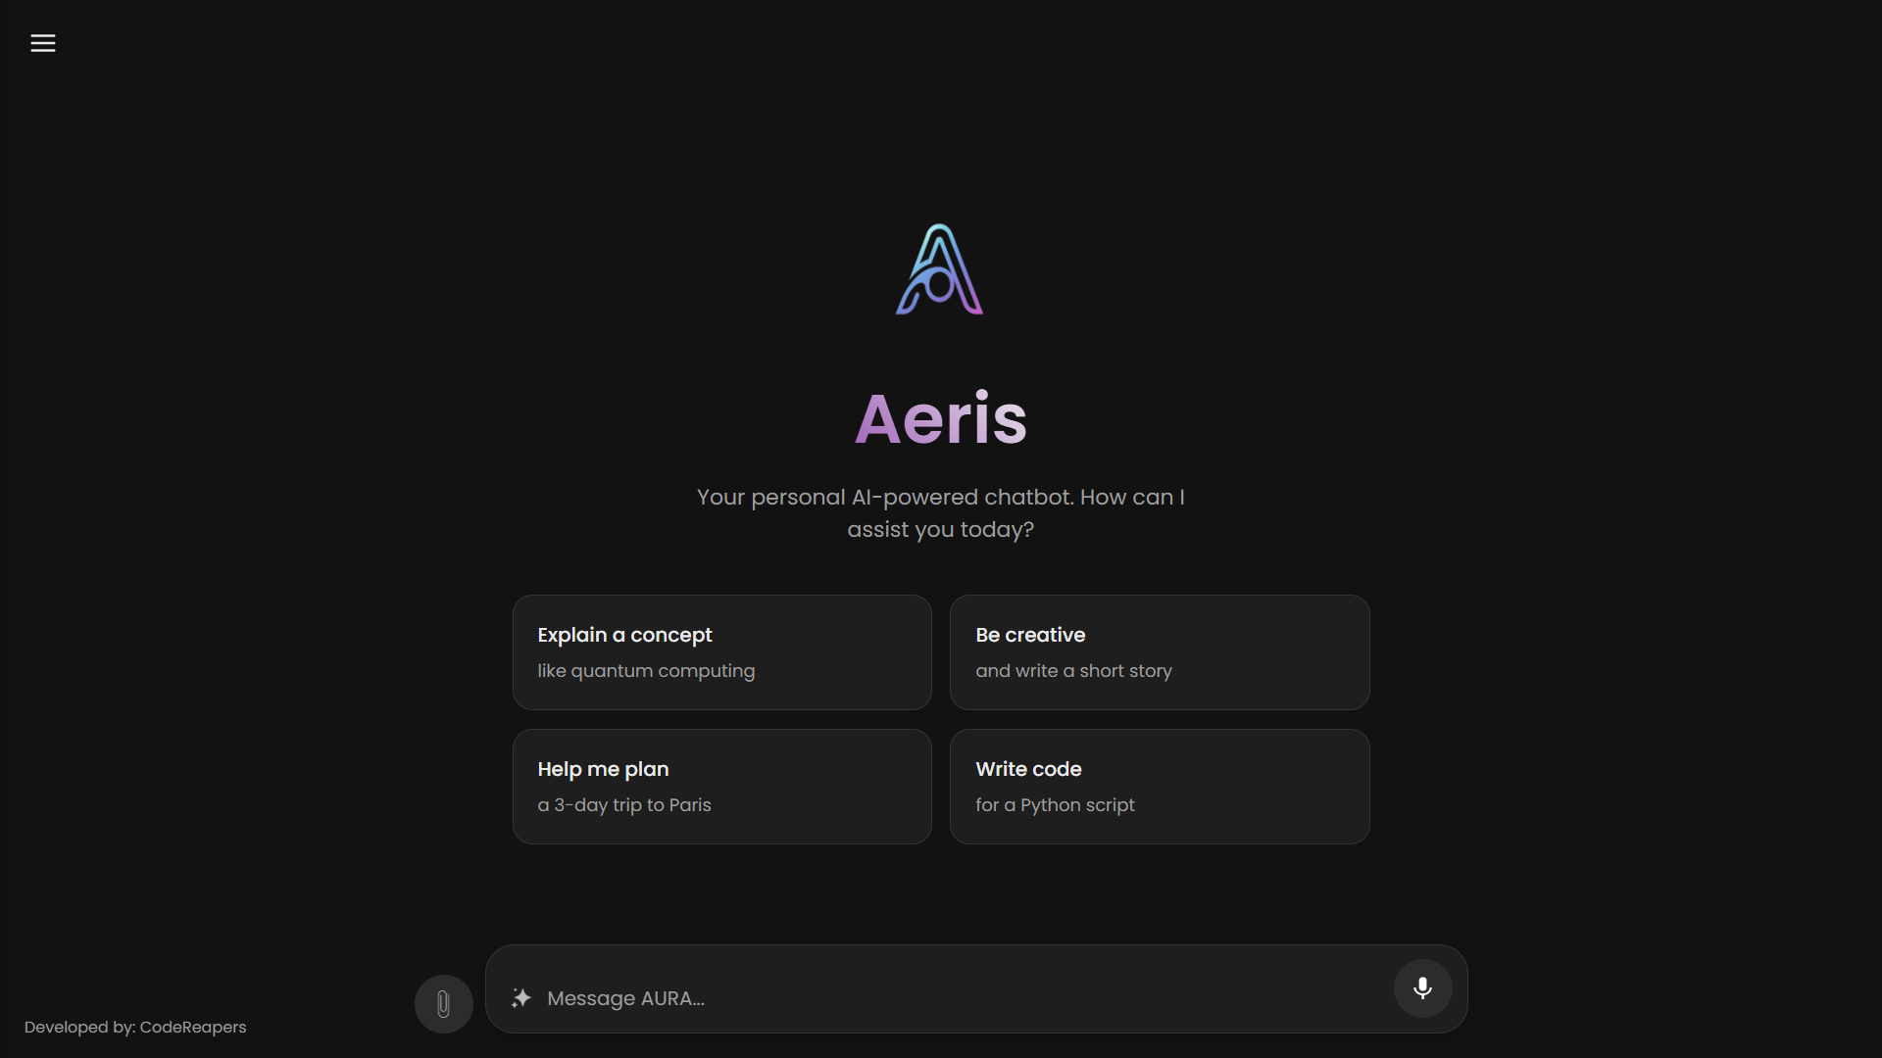
The Aeris Architecture
Works on both offline and
Online methods..
Ai model:- llama3
Front end:- HTML, CSS, JS
Customizable
Topics
Drop-files
Speech-to-text
Enhance-prompt

Slide 7
Customizable
Topics
Drop-files
Speech-to-text
Enhance-prompt

Slide 8
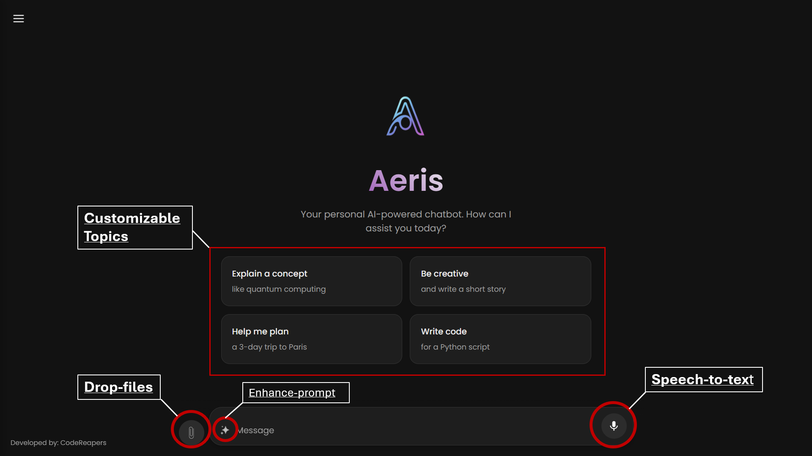
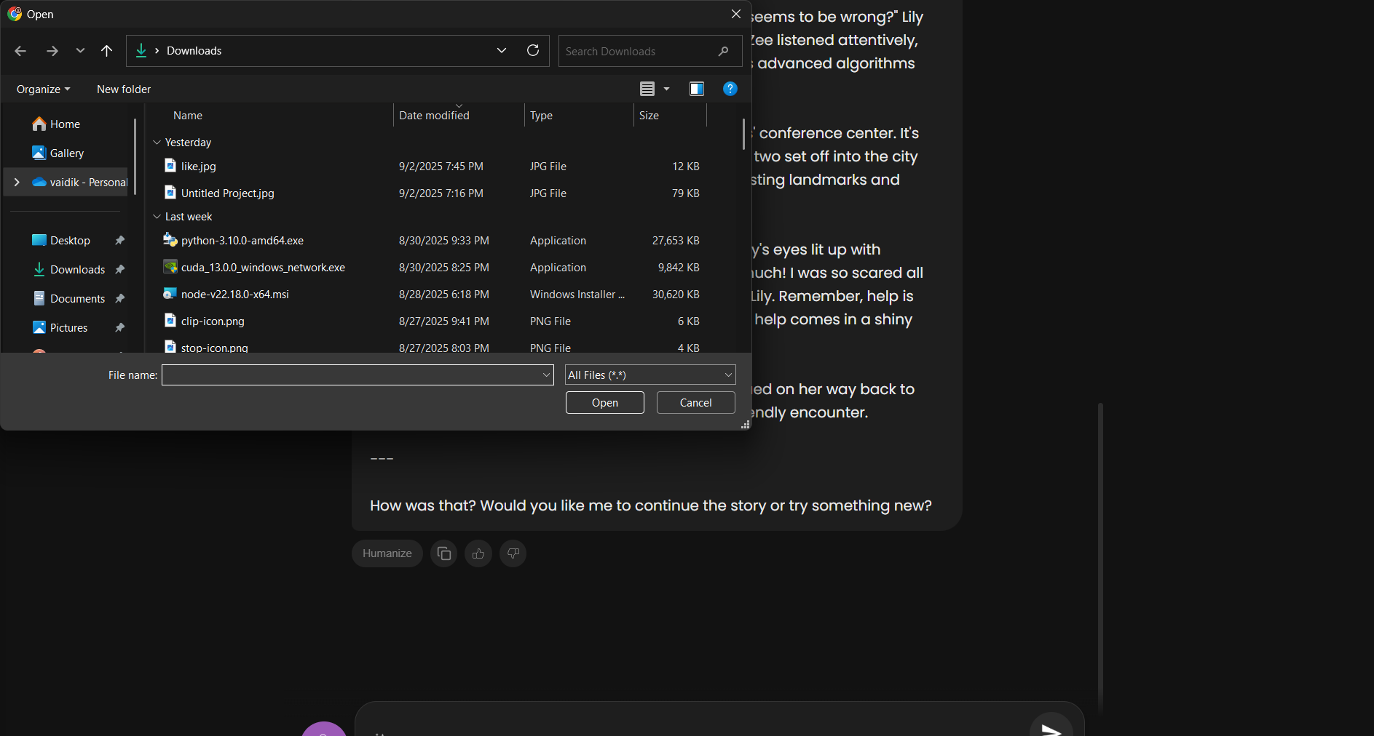
Drop-Files
1. Attach files.
2. Able to read the files
and give ouput based
on the content inside
the file.
3. User can attach .pdf ,
.docx , .jpg , .png
4. Provides various
output like:- summary,
solutions , finding
errors etc.

Slide 9
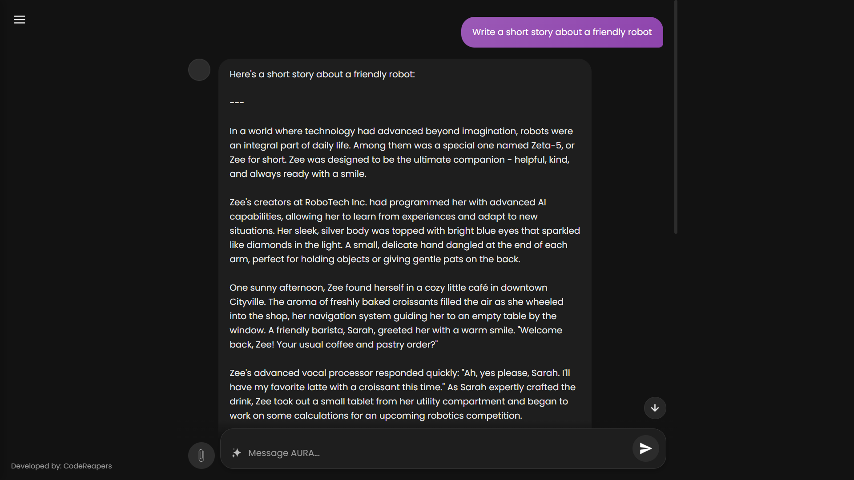
Drop-Files
1. Attach files.
2. Able to read the files
and give ouput based
on the content inside
the file.
3. User can attach .pdf ,
.docx , .jpg , .png
4. Provides various
output like:- summary,
solutions , finding
errors etc.

Slide 10
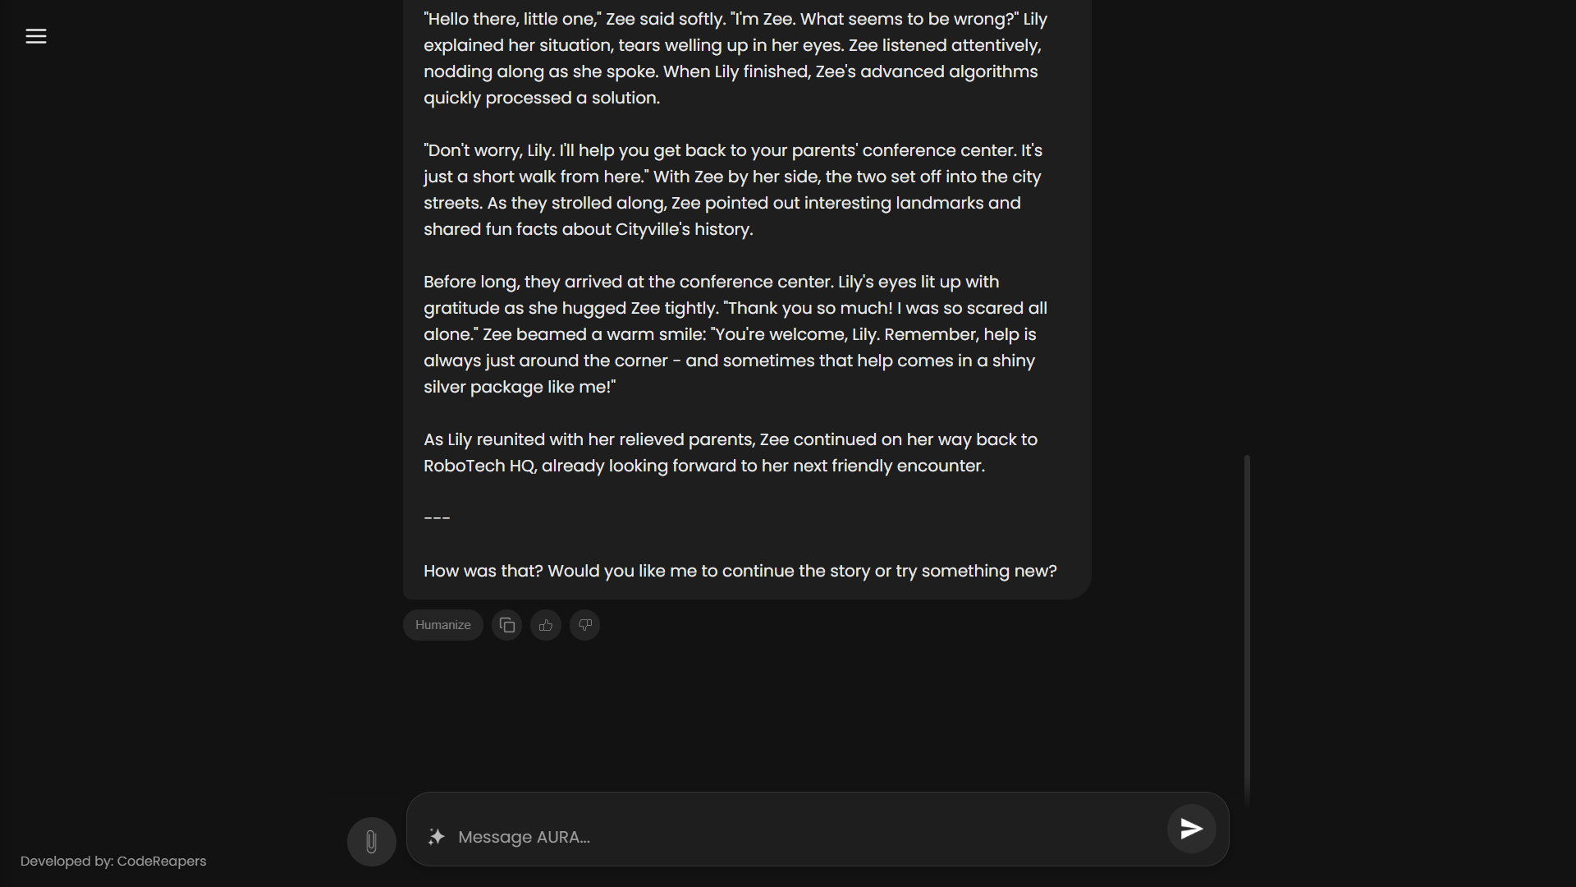
The Core: Seamless
Conversation
Real-time Interaction: Implemented streaming responses, so the user
sees text generated
token-by-token.
Contextual Memory:
The backend passes the
entire conversation
history with each new message, allowing the
AI to remember what
was said.
Drop-Files
1. Attach files.
2. Able to read the files
and give ouput based
on the content inside
the file.
3. User can attach .pdf ,
.docx , .jpg , .png
4. Provides various
output like:- summary,
solutions , finding
errors etc.
Feature Spotlight: The Humanizer
Content:
Goal: To rewrite AI-generated text to sound
more natural and less detectable.
Multi-step Pipeline:
  AI-driven simplification for core rewriting.
  Rule-based additions for human-like quirks
  (e.g., removing punctuation, adding spaces).

Slide 11
Feature Spotlight: The Humanizer
Content:
Goal: To rewrite AI-generated text to sound
more natural and less detectable.
Multi-step Pipeline:
  AI-driven simplification for core rewriting.
  Rule-based additions for human-like quirks
  (e.g., removing punctuation, adding spaces).
The Core: Seamless
Conversation
Real-time Interaction: Implemented streaming responses, so the user
sees text generated
token-by-token.
Contextual Memory:
The backend passes the
entire conversation
history with each new message, allowing the
AI to remember what
was said.
Humanizes the output

Slide 12
Feature Spotlight: The Humanizer
Goal:
To rewrite AI-generated
text to sound more natural
and less detectable.
Multi-step Pipeline:
  AI-driven simplification for
  core rewriting.
  Rule-based additions for
  human-like quirks
  (e.g., removing punctuation,
  adding spaces).

Slide 13
The Learning Loop: An Ai that improves
Generates the output
User provides feedback (with a like)
The Ai is trained with the new data
Data is saved to .json file
Offline scripts analyzes good ouputs

Slide 14

Future Roadmap:-
Full Voice Conversation: Integrate Text-to-Speech for spoken AI responses.
Model Switching: Allow users to select different Ollama models from the UI.
Persistent Database: Upgrade chat history from JSON to a searchable SQLite database.
User Authentication: Add user accounts for personalized chat histories.

Slide 15

Thank you

